Slide 1
Physical Security
Kirsten Hanson
GenCyber Workshop

Slide 2
Agenda
What is physical security?
Why does physical security matter?
What are the risks of poor physical security?
What are the different threats to physical security?
What are some physical security countermeasures?
Take a look at physical security in action

Slide 3
Learning Objectives
Identify components of Physical Security Layer
Identify security risks
Describe potential solutions to mitigate the security risks

Slide 4

What is Physical Security?
Physical security is the protection of hardware, software, networks, and data from physical threats
How does this apply to cyber security?

Slide 5
Why Physical Security Matters
If physical security is not up to par then the hardware, software, networks, and data belonging to the respective institution(s) are left vulnerable
For example, if hardware is stolen or damaged, the data is stolen or damaged

Slide 6
Risks of Poor Physical Security
Unauthorized access
Data loss/corruption
Hardware loss/corruption
Loss of proprietary information
General misuse of hardware, software, data, or networks

Slide 7
Physical Security Threats
Criminal Acts
Theft, attacks, vandalism
Accidental Acts
Spilled coffee, tripping over wires
Environmental conditions
Humidity, extreme temperatures, lightning
Natural occurrences
Tornado, earthquake, tsunami, flooding

Slide 8
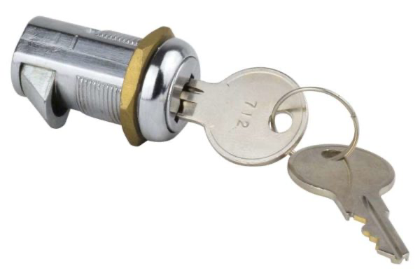
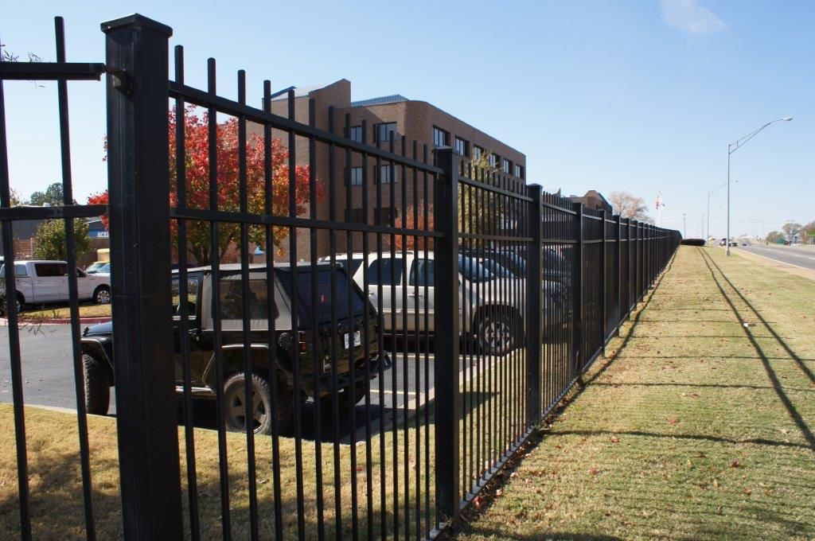
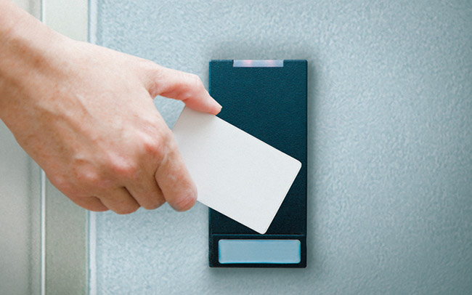
Physical Security Countermeasures
Interior walls and doors
Locks/keys
Exterior walls, fencing, gates
Security guards
Security dogs
Fireproof construction materials
Fire detection/suppression systems
Access badges and ID cards
Alarm systems
Video surveillance
Wiring closets
Checklists

Slide 9
Physical Security in Action
While we can get a relatively comprehensive list of physical security countermeasures, there are nearly countless ways to implement and improve physical security
Not only should physical security be implemented from the beginning, but it should also be tested regularly and updated as often as feasible
Violations should be addressed swiftly and seriously

Slide 10
Remember...
There always should be more than one physical security countermeasure in place
There are countless combinations of physical security countermeasures
Inspections and regular checks of the system in place are necessary to maintaining an effective system

Slide 11
Additional Resources
Protecting Physical Security Systems against Network Attacks
https://www.trendmicro.com/vinfo/us/security/news/internet-of-things/protecting-physical-security-systems-against-network-attacks
Why Physical Security Is Just As Important As Online Security
https://www.ittropolis.com/physical-security-just-important-online-security/
Physical Security Facts
https://sites.google.com/a/pccare.vn/it/security-pages/physical-security-facts

Slide 12
Activity
See the Physical Security handout and complete the activity

